Slide 1
A NOVEL METHOD FOR HAND WRITTEN DIGIT RECOGNITION
PROJECT STUDENTS:
Suvetha S 1904059
Shunmathi D 1904048
Sujeetha S 1904055
Suharini C 1904054

Slide 2
PROBLEM STATEMENT
The goal of this project is to create a model that will be able to recognize and determine the handwritten digits from its image by using the concepts of Convolution Neural Network.
Though the goal is to create a model which can recognize the digits, it can be extended to letters and an individual’s handwriting.
The major goal of the proposed system is understanding Convolutional Neural Network, and applying it to the handwritten recognition system.

Slide 3
INTRODUCTION
Digit recognition system is the working of a machine to train itself or recognizing the digits from different sources.
It is a hard task for the machine because handwritten digits are not perfect and can be made with many different flavors.
The handwritten digit recognition is the solution to this problem which uses the image of a digit and recognizes the digit present in the image.

Slide 4
LITERATURE SURVEY
S.NO | TITLE | MODEL / TECHNIQUES USED | MERITS/ DEMERITS | OUTCOMES
1. | Rohan Sethi, Ila Kaushik(2020),”Hand Written Digit Recognition using Machine Learning”,IEEE Xplore ,vol.10,Issue No. 24 | K Nearest Neighbour | With large data, the prediction stage might be slow. Require high memory – need to store all of the training data. | X : array-like, last dimension same as that of fit data.The new point. n_neighbors : int Number of neighbors to get
2 | Kh Tohidul Islam, Ghulam Mujtaba, Dr. Ram Gopal Raj, Henry Friday Nweke, (2017), “Handwritten digits recognition with artificial neural network”, IEEE Xplore, vol. 7, Issue No. 12, pp.no. 1448-1451. | Artificial Neural Network | They have used digit images pixels as features vector and ANN as classifiers for handwritten digits recognition. | Two parameters were provided to ANN.The first indicates the number of classes in the dataset.

Slide 5
LITERATURE SURVEY
S.NO | TITLE | MODEL / TECHNIQUES USED | DEMERITS | OUTCOMES
3. | Eva Tuba and Nebojsa Bacanin(2016) “An Algorithm for Handwritten Digit Recognition.Using Projection Histograms and SVM Classifier”IEEE Xplore ,vol.10,Issue No. 24 | Support vector machine and projection histograms | Long training time for large datasets. Difficult to understand and interpret the final model, variable weights and individual impact. | Two parameters must be considered: C and gamma . The parameter C , common to all SVM kernels

Slide 6
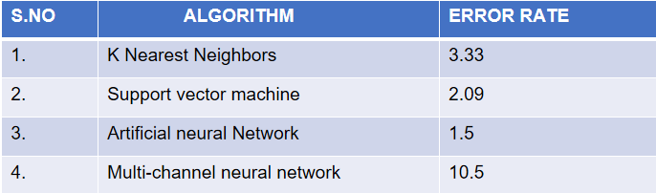
INFERENCE FROM LITERATURE SURVEY
.
Looking for less error rate algorithm was difficult.
Searching for dataset for our project.

Slide 7
PROPOSED SYSTEM WORK
By comparing above algorithms ,error rate are high.
So we resolved it by using Convolution neural network with error rate 1.28%.
A Convolutional Neural Network or CNN is a Deep Learning Algorithm which is very effective in handling image classification tasks.
Our model will process the image to identify the digit and return a series of 10 numbers corresponding to the ten digits with an activation on the index of the proposed digit.
A convolutional neural network (CNN) is used in image recognition and processing that is specifically designed to process pixel data.

Slide 8
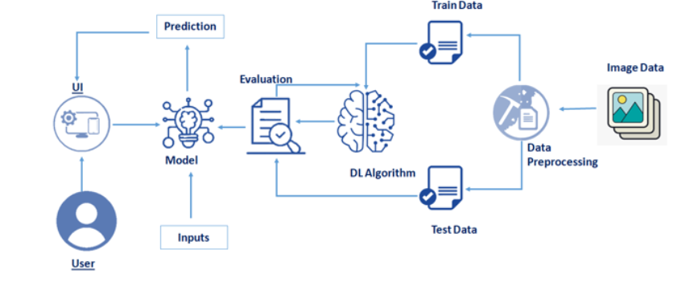
PROPOSED SYSTEM MODEL

Slide 9
HARDWARE/ SOFTWARE TOOL USED
SOFTWARE USED
•MNIST Data set
•Python IDLE

Slide 10
REFERENCES
[1] Rohan Sethi, Ila Kaushik(2020),”Hand Written Digit Recognition using Machine Learning”,IEEE Xplore ,vol.10,Issue No. 24
[2] Kh Tohidul Islam, Ghulam Mujtaba, Dr. Ram Gopal Raj, Henry Friday Nweke, (2017), “Handwritten digits recognition with artificial neural network”, IEEE Xplore, vol. 7, Issue No. 12, pp.no. 1448-1451.
[3] Eva Tuba and Nebojsa Bacanin(2016) “An Algorithm for Handwritten Digit Recognition.Using Projection Histograms and SVM Classifier”IEEE Xplore ,vol.10,Issue No. 24

